Slide 1
Name :- Rathore Pradeep EN:- 2104030100847 Division :- H

Slide 2

.NET Framework Introduction, code compiled process, language ,Technology

Slide 3

What is .NET Framework ?
1
.NET REPRESENT :-
.NET is a framework tool that supports many programming languages and many technologies.
.NET support 32 programming language , 9 are design by Microsoft and remaining are designed by non-Microsoft
.NET Framework is a software development Framework
The first version of the .NET Framework was released in the year 2002
.NET programs are executed in CLR
.NET is Developed by Microsoft
Possible to develop console Application, windows Application, web Application, mobile application

Slide 4
Languages
C programming
C#.NET
C and C++ Programming
C#.NET
Java programming
J#.NET
Visual Basic
VB.NET
Classic ASP
ASP.NET

Slide 5
Compilation Process
VB.NET
C#.NET
Other language
VBC
CSC
Appropriate compiler
MSIL (Microsoft intermediate Language)
Just in time (JIT)
Machine code

Slide 6
.NET Framework ,code Compiled process
In the 1st compilation ,the source code Is compiled by respective language compiler and generate the intermediate code which is known as MSIL (Microsoft intermediate Language) or IL (Intermediate Language code) or Manage code.
In the second compilation, MSIL is Converted into Native code specific to operating system so that the code is executed by the operating system ) using CLR.
Always 1st compilation is fast.

Slide 7
What is technology and its Needs ?
Technology is always designed for a particular purpose
For example development of web-related application in .NET using a technology ASP.NET
But the technology does not offer any specific for writing the programs .that’s why technology can’t be implemented individually
VB.NET, C#.NET both are programming languages we can implement windows/desktop applications individually.
Every language is having its own compilier like C# have CSC Compilier and VB have VBC Compilier.

Slide 8
What does the .NET Framework provide ?
The .NET Frame provides two things are as follows :-
BCL (Base class Libraries)
CLR (Common Language Runtime)
BCL (Base class libraries) :
Base Class Libraries (BCL) is designed by Microsoft.
Without BCL we can’t write a code in .NET .
SO, BCL is also known as a building block of .NET Programs.
These are installed in a machine when we installed the .
NET Framework. BCL Contain pre-defined classes and
these class are used for the purpose of application Development.
The physical location of BCL is c:\windows\assembly

Slide 9
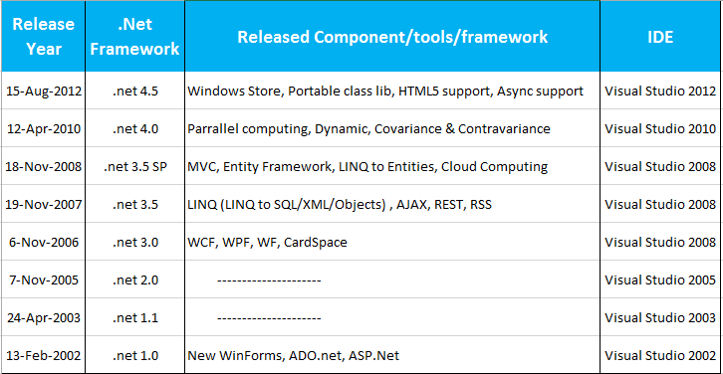

Slide 10
CLR ( Common Language Runtime):
CLR stands for common Language Runtime and its the core component under the .NET Framework which is responsible for converting the MSIL(Microsoft intermediate Language)code Into native code then execution.

Slide 11
What is JIT ?
JIT stands for the just-in-time compilier. It is the component of CLR WHICH IS responsible for converting MSIL code into Native code . This native code is directly understandable by the operating system.

